Slide 1
hi

Slide 2
admin

Slide 3
games
disaster
ethics
review
test
thanksgiving
final project

Slide 4
game maps
Notes:
6th Century – Anaximander 6th Century BC

Slide 5
who cares
Notes:
So seriously, who tf cares? Well, what we’re talking about with games and how games use map is intimately tied to how we use maps normally in the present. What we started with this work is the idea that the map exists and is discussed by more than just cartographers, municipal leaders, app makers, and geographers. The map has a very robust kind of social life.
What do I mean by this?
Well, let’s consider this idea: increased technological delivery of information does not in and of itself contribute to a better future

Slide 6
better tech does not make a better future on its own
Notes:
So seriously, who tf cares? Well, what we’re talking about with games and how games use map is intimately tied to how we use maps normally in the present. What we started with this work is the idea that the map exists and is discussed by more than just cartographers, municipal leaders, app makers, and geographers. The map has a very robust kind of social life.
What do I mean by this?
Well, let’s consider this idea: better tech does not make a better future on its own. We need to constantly discuss it.
Recall that I have been saying throughout our time with GIS that the UI is very strange. It is because ESRI develops in a vaccum. They do not fund research into a better project, they rely on themselves and user metrics, and will grab UI from elsewhere. Why?
Well, let’s talk about a paradox.

Slide 7
users will never be better than adequate with your technology
Notes:
The goal of discussing the way others use map technologies, how we play with it, how we constantly change it is about geospatial content is more about where this information should be situated within society rather than that of how maps work.
If users will never be better than adequate, ESRI has run with this and simply prescribed the ways that map information should be consumed. There are other ways to deal with this kind of info and while we are talking about games – which are often belittled as a waste of time – the technologies themselves (and what inspired them) are constantly struggling to find more effective ways to bring users into technologies.

Slide 8
your critical eye is an important thing to develop
Notes:
The goal of discussing the way others use map technologies, how we play with it, how we constantly change it is about geospatial content is more about where this information should be situated within society rather than that of how maps work.
If users will never be better than adequate, ESRI has run with this and simply prescribed the ways that map information should be consumed. There are other ways to deal with this kind of info and while we are talking about games – which are often belittled as a waste of time – the technologies themselves (and what inspired them) are constantly struggling to find more effective ways to bring users into technologies.

Slide 9
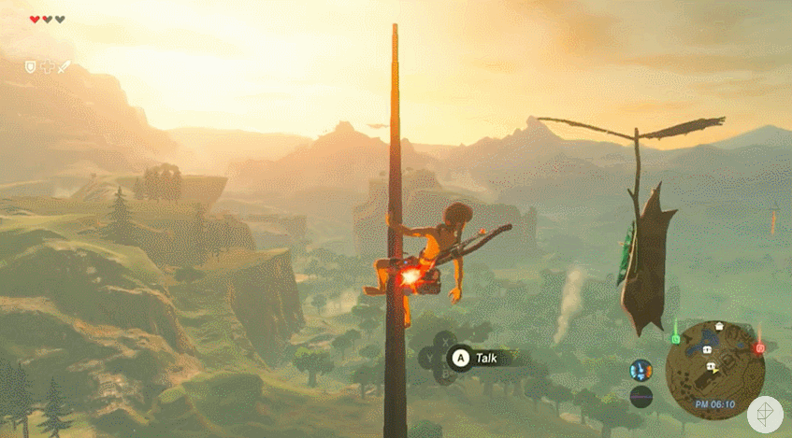
Inspiration
Notes:
We were struck by the size of the map for Breath of the Wild but also the mapping system. How did this thing appear? Was there any history? Were there affordances that did not get followed?

Slide 10
assignment!
Notes:
6th Century – Anaximander 6th Century BC

Slide 11
~ or at least 1000 words - at least 10 images - PDF - must answer the following
Notes:
For the love of all things holy, don’t fill your submission with useless words. Concentrate on doing the job.

Slide 12
select a map
Notes:
find a map, map interface, etc… from a game, movie, tv show, or anything (it can’t exist in the real world)

Slide 13
write an FAQ about how this map conveys its information
Notes:
6th Century – Anaximander 6th Century BC

Slide 14
how would you change it? why those changes?
Notes:
Some of you have been working on some maps for things you’re making, you can also write about that.

Slide 15
caveats:
Notes:
Some of you have been working on some maps for things you’re making, you can also write about that.

Slide 16
justify your choices must use current tech think “near future”
Notes:
So what does that mean?

Slide 17
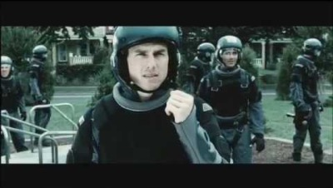
Notes:
Some of you have been working on some maps for things you’re making, you can also write about that.

Slide 18
examples

Slide 19
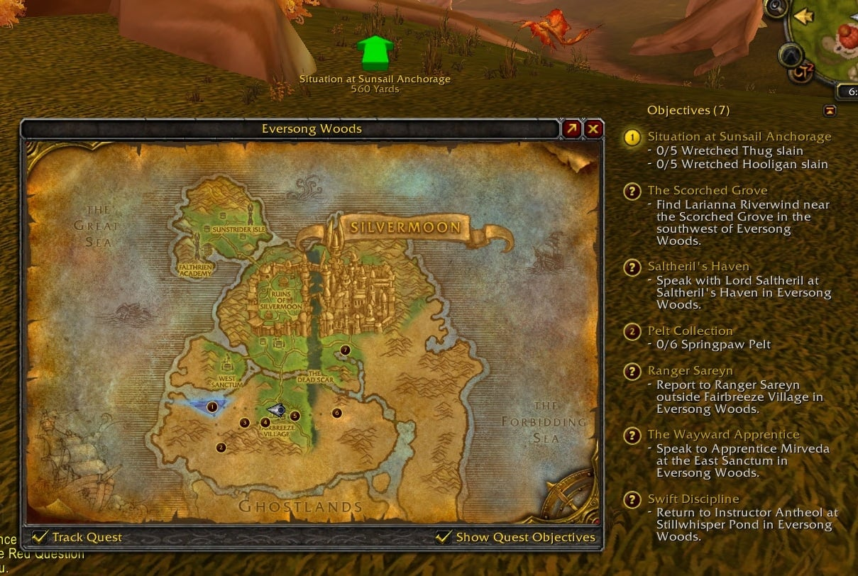

Slide 20
http://heavenswhere.com/
https://mapgenie.io/pokemon-scarlet-violet/maps/paldea-region
http://lotrproject.com/map/#zoom=3&lat=-1315.5&lon=1500&layers=BTTTTT

Slide 21
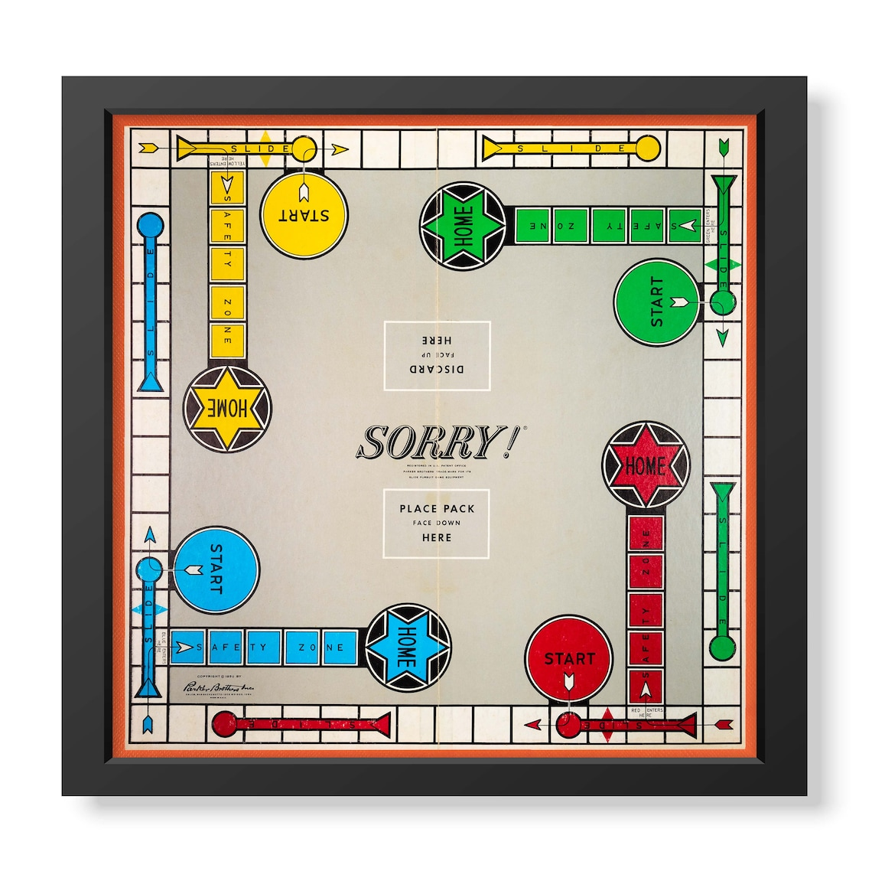

Slide 22
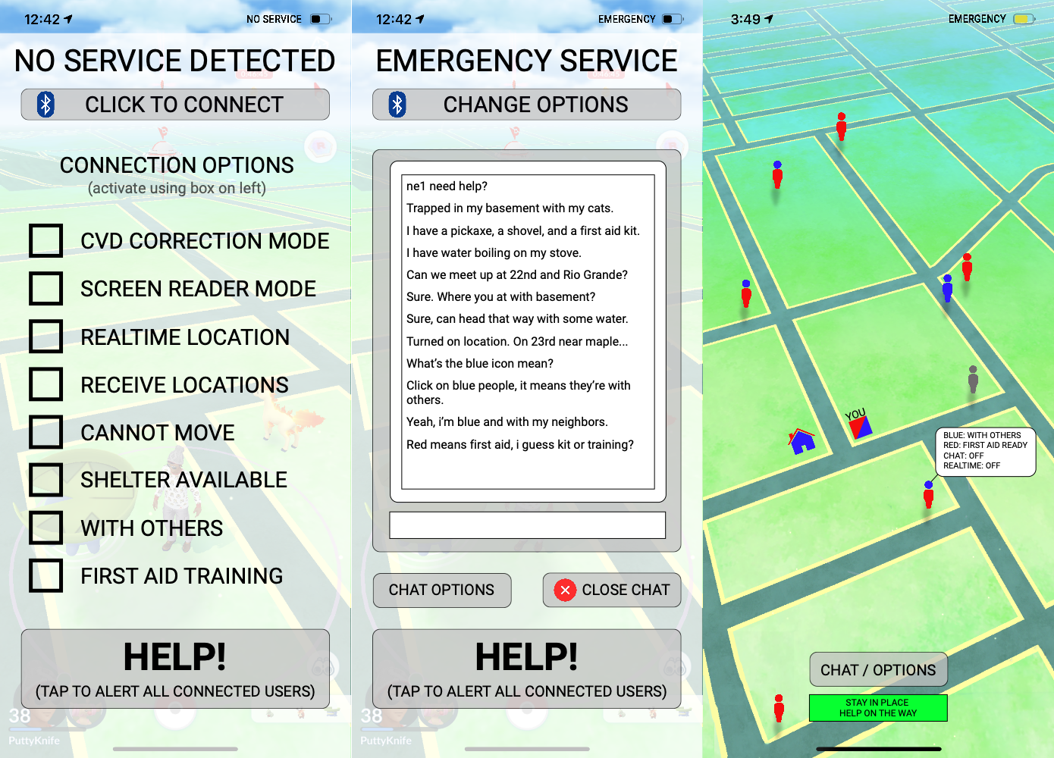

Slide 23
end of day 1

Slide 24
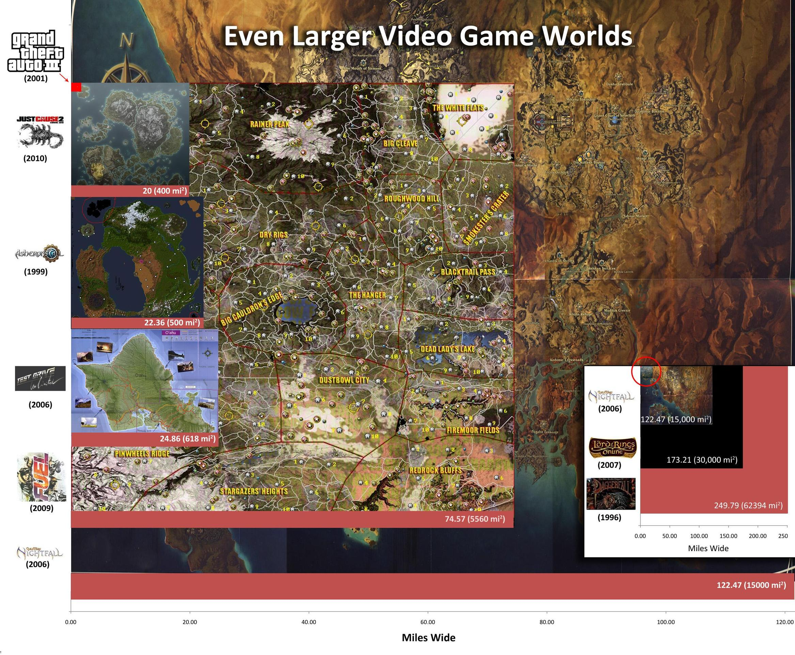
Notes:
We were struck by the size of the map for Breath of the Wild but also the mapping system.

Slide 25
Maps in Video Games
medium
Tool

Slide 26
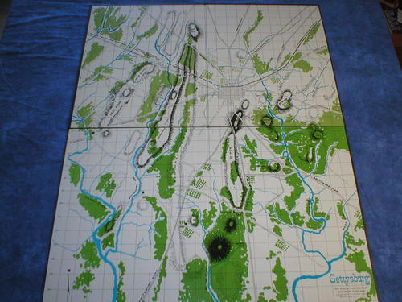
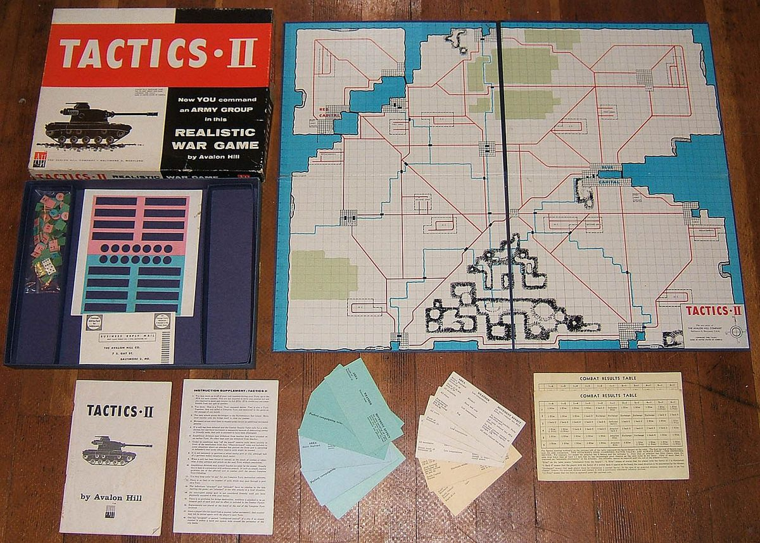
where to begin?
Notes:
Abstracted boards for chess, go, and other strategy / training games. But the commercial map for games begins with the publication of Tactics 2 by Avalon Hill. Tactics was published out of the house of the founder of Avalon Hill – Charles S. Roberts – whereas Tactics 2 (1), Gettysburg (2), and Dispatcher were their first games.
As a minor point on the history of chess, the "queen" was, until quite recently, called not the "queen" but the "general," "prime minister," or other similar titles to represent the piece's true function, namely, the actual head of the army who had under his personal command the most powerful troops. This is why the "queen" piece is so powerful. Not only does it represent the single best body of troops, but also the very leadership of the army. The king, on the other hand, is indeed the king of the kingdom, without whose presence the army is lost. Thus, the king is not necessarily a soldier of any particular talent. During the battle his main function is to survive and to serve as a symbol, a rallying point for his army.
By the early 19th century Prussians, civilians as well as members of the Prussian Army, developed the first detailed and realistic wargames. These were used for training, planning and testing military operations. The mechanics of the games were developed after careful study of actual military maneuvers and battles. After the wars of German unification concluded in 1871, the Germans made no secret of their new technique, and most European armies quickly followed their lead. However, no one took it as seriously as the Germans, and no one got as much out of it as the Germans.
About the turn of the century, the famous science fiction writer H. G. Wells wrote a book called Little Wars. This book described a somewhat simpler form of the wargames than those used by the professionals. Wells' game used toy metal soldiers to represent the military units, and is another of the direct antecedents of contemporary wargames.
Up until World War II, the majority of the wargames available involved battles. The planning for larger operations was not so much a game as it was a paper-shuffling exercise directed toward solving the puzzle of getting all the pieces moving at the right place and time, much like planning a railroad schedule.

Slide 27
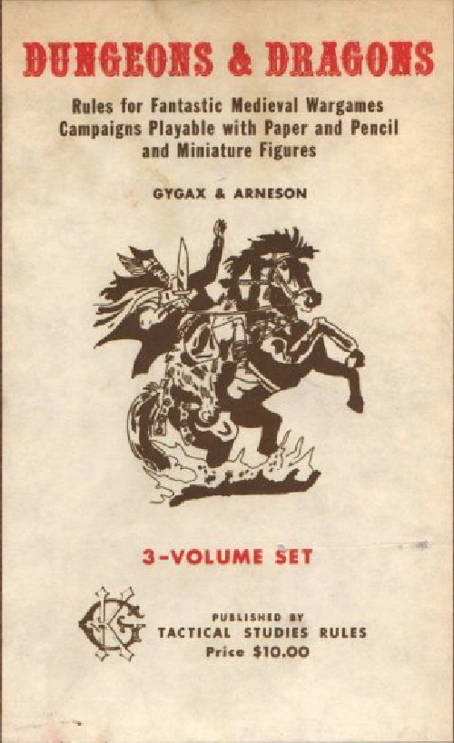
where to begin?

Slide 28
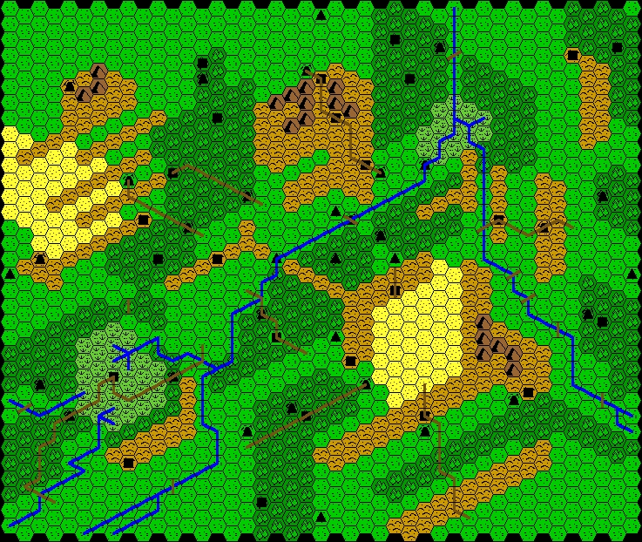
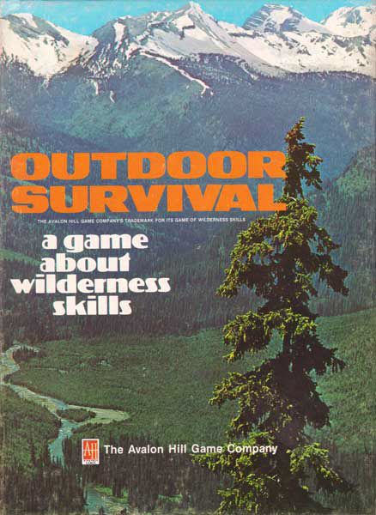

Slide 29
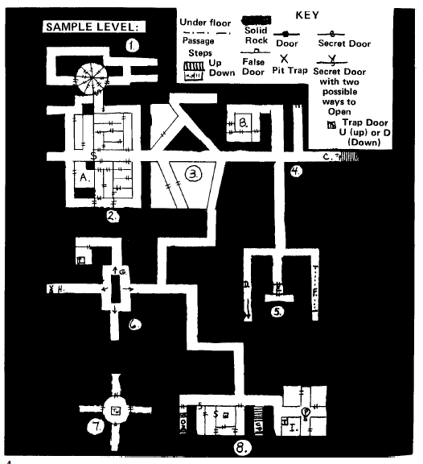
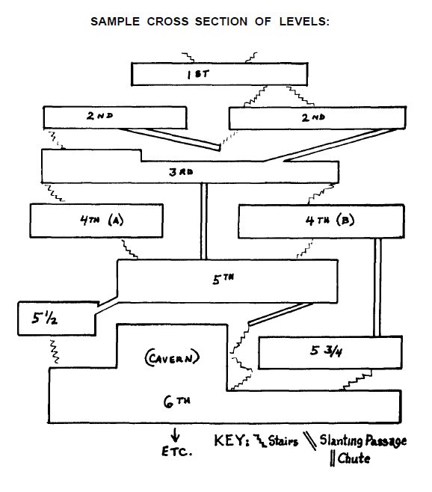
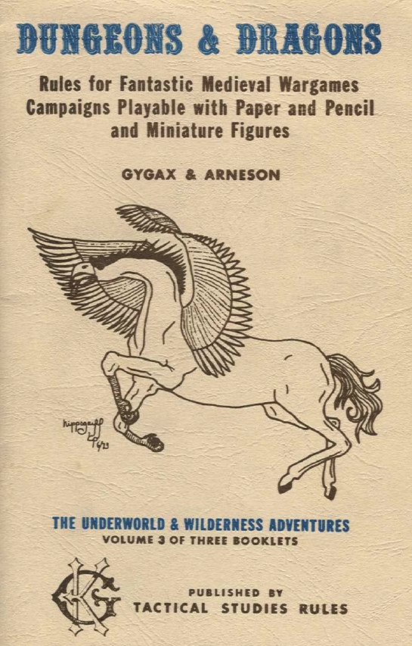
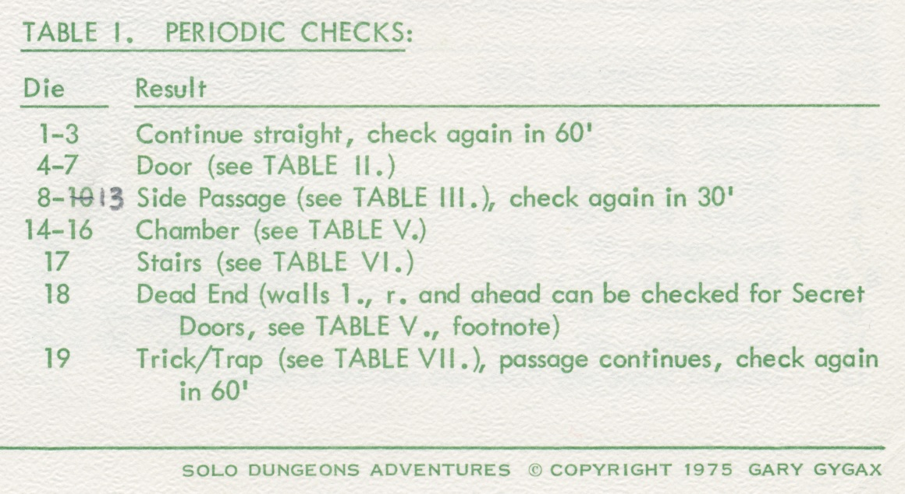
The Dungeon Crawl

Slide 30
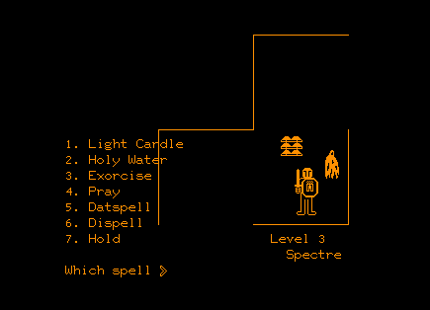
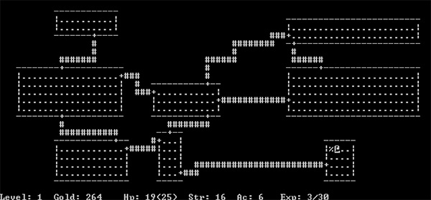
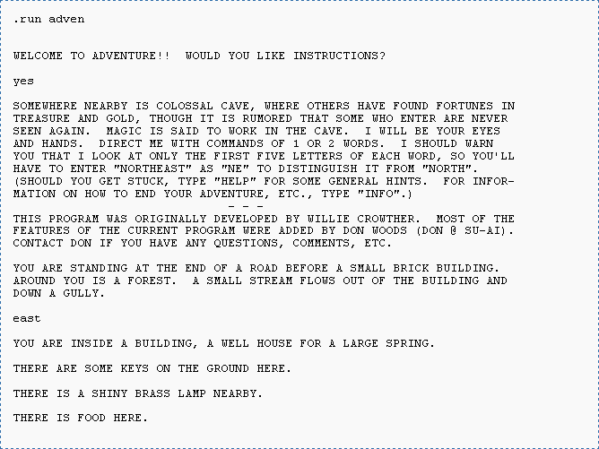
Computer-Mediation Begins
Notes:
Pedit5 - I used the basic features of D&D as much as possible: hit points, monster levels, experience and treasure awards, and so on; the character was a combined fighter / magic user / cleric; in a monster encounter, the character had a choice of fight (F), cast a spell (S) or run (R); after that, if the monster was not defeated or avoided, it was a fight to the finish run entirely by the computer.
Dnd – Expanded on Pedit5, included the what would become known as dungeon bosses.
Colossal Cave Adventure – Forced Paper mapping – we see a split among these things. Forced paper mapping in text adventures vs random dungeons in what would become roguelikes. – Twisty Little Passages
Rogue – What and Why they matter?

Slide 31
Divergent Paths
Notes:
Split affordances – text-based paper mapping and

Slide 32
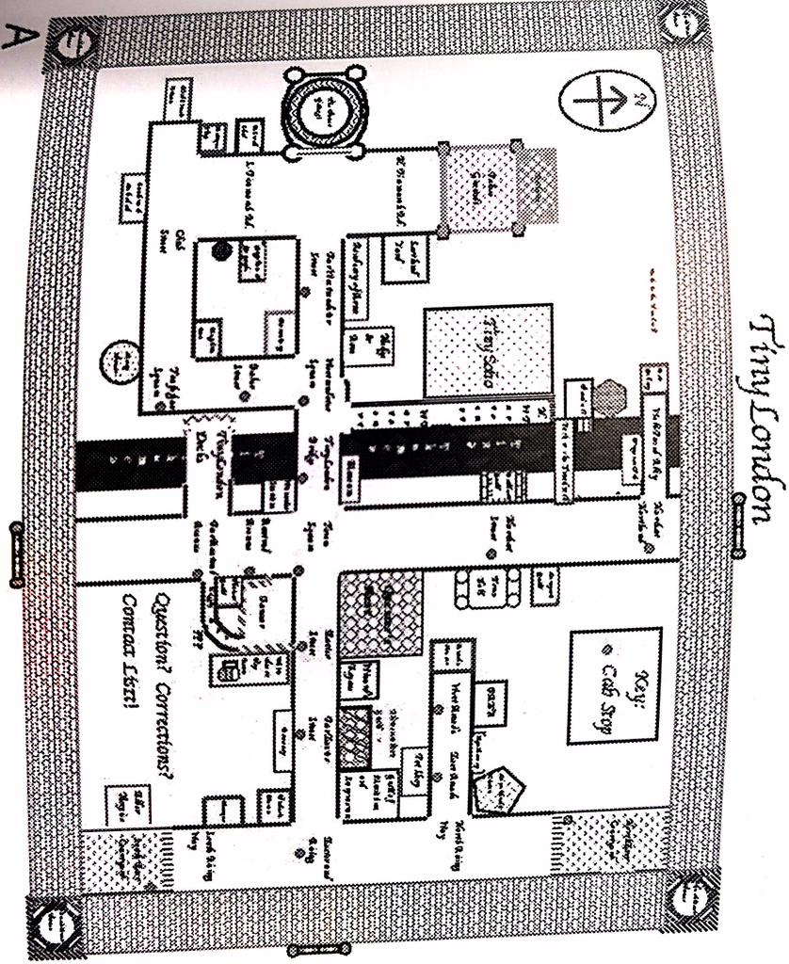
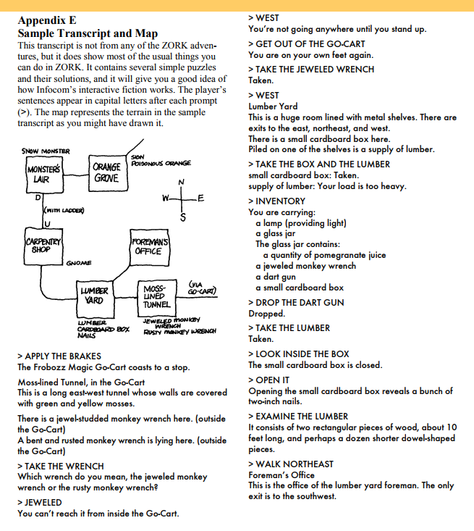
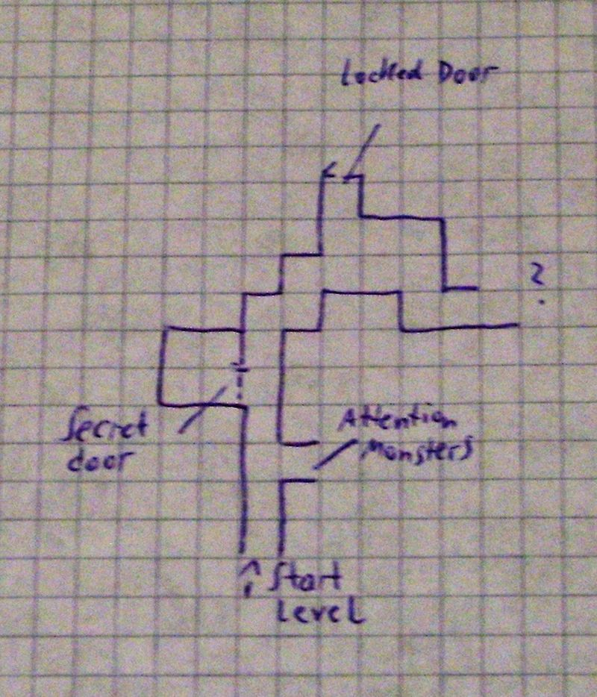
Read and Draw
Notes:
Split affordances – text-based paper mapping and
Zork,

Slide 33
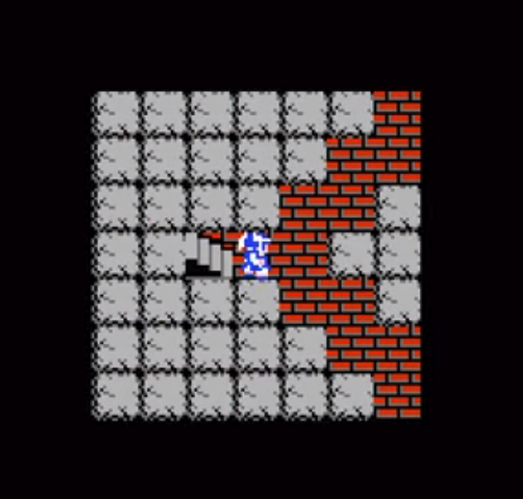
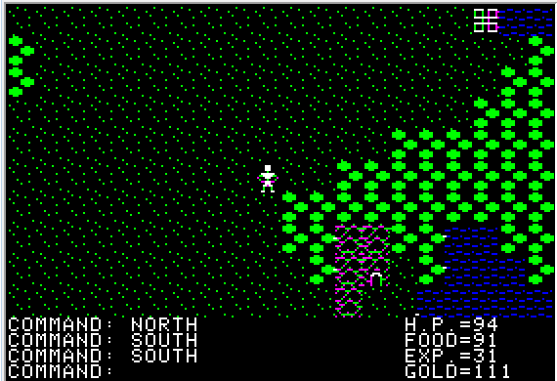
See and Memorize
Notes:
Split affordances – text-based paper mapping and

Slide 34
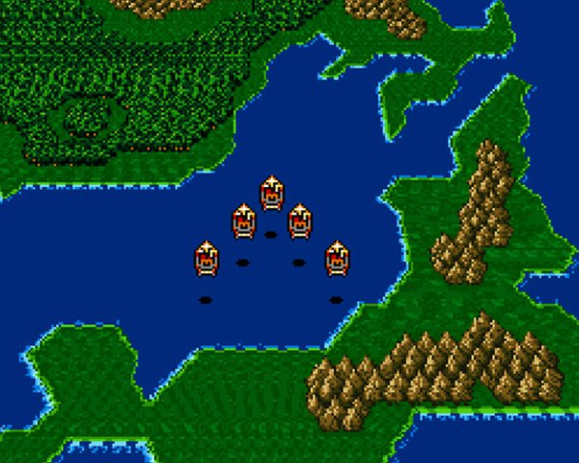
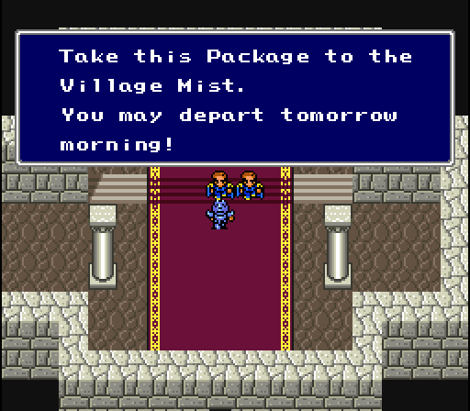
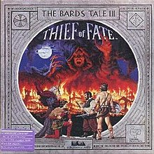
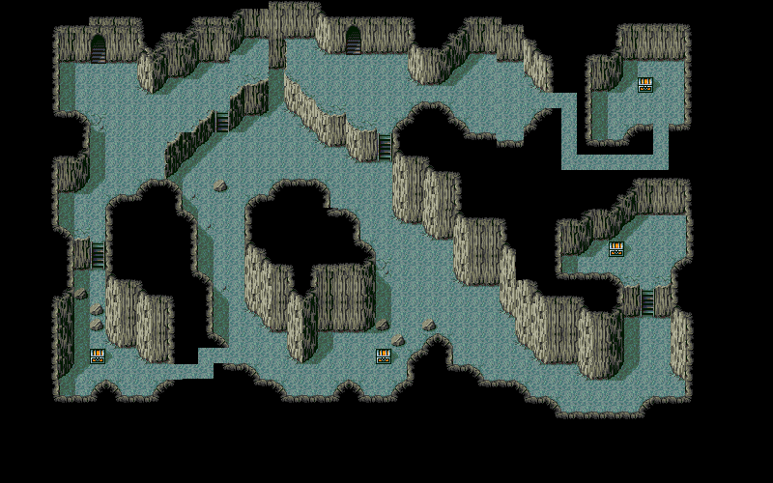
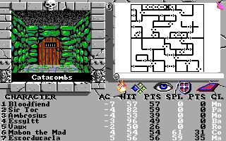
Automation and Narrative
Notes:
The Bard’s Tale III was one of the earliest games with automapping, another gaming innovation that became widely used. How did we ever play without it?
Maps become integrated within the game as a whole. -1988
"Dave, Max, and Erich couldn’t argue against the grim state of computer role-playing games. CRPGs had derived from Dungeons & Dragons and remained graphical interpretations of that decades-old formula: players drew maps on graph paper as they explored dungeons since most games did not generate maps automatically, virtual dice rolls determined whether players hit or missed when they attacked and how much damage they dealt in combat, and most games unfolded over turns. Many CRPGs also recycled graphics from older games, making newer titles look dated. In contrast, other game genres took advantage of cutting-edge hardware such as video cards and CD-ROM. In 1993, developer Cyan released Myst , a graphical tour de force where players explored photorealistic worlds. Far more popular were the hordes of first-person shooters influenced by Doom . Casual gamers took one look at the archaic graphics of RPGs and passed them over in favor of games that satisfied their bloodlust and justified their investments in top-of-the-line computer hardware. As developers of RPGs struggled to keep up with technology and gamer tastes, their games plummeted in quality."
― from "Stay Awhile and Listen: Book I Legendary Edition: How Two Blizzards Unleashed Diablo and Forged a Video-Game Empire“
Final Fantasies also appear here. Still Dungeons, but not so difficult to traverse as they are more story / narrative oriented. Gameplay still running around on the overworld map.

Slide 35
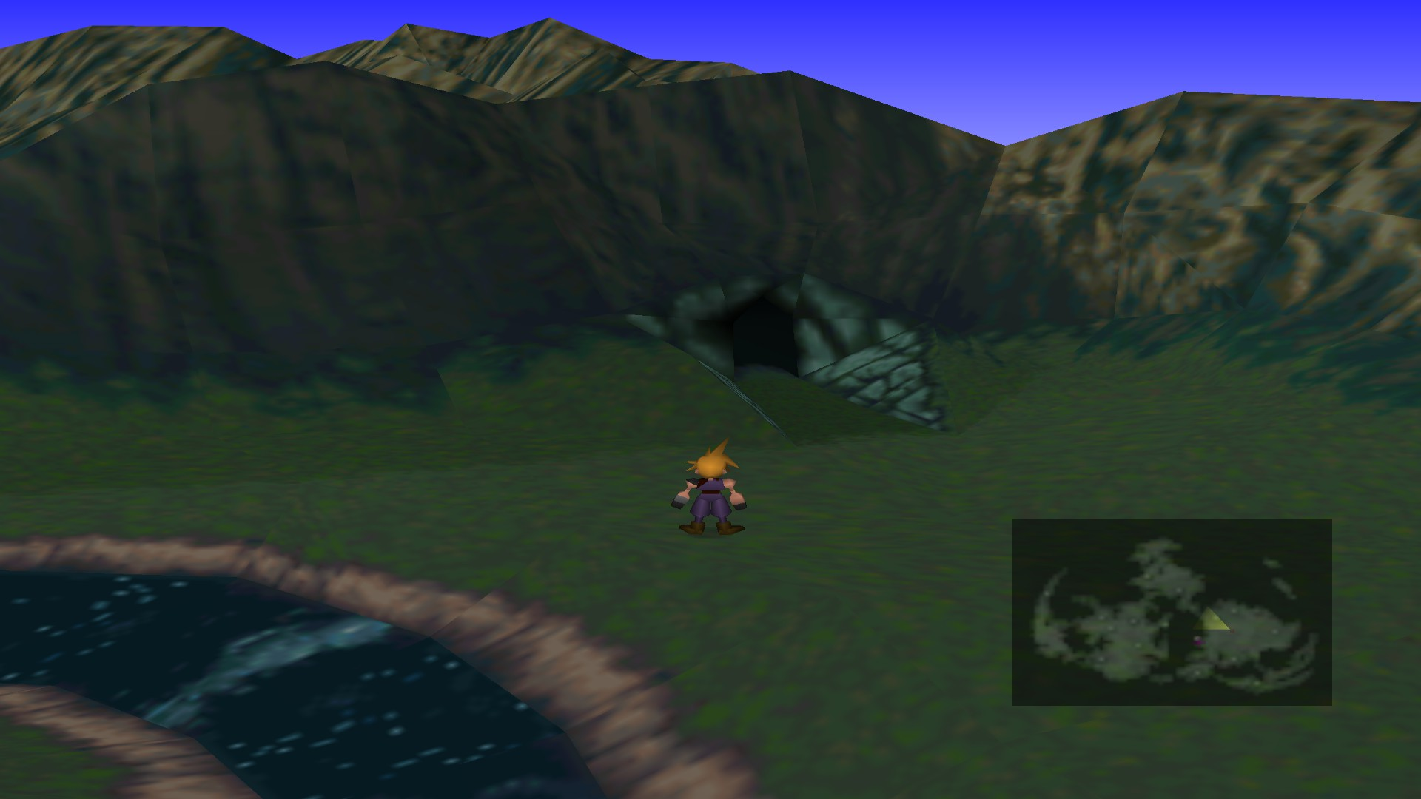
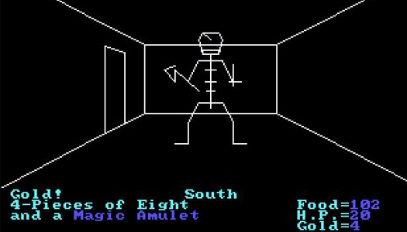
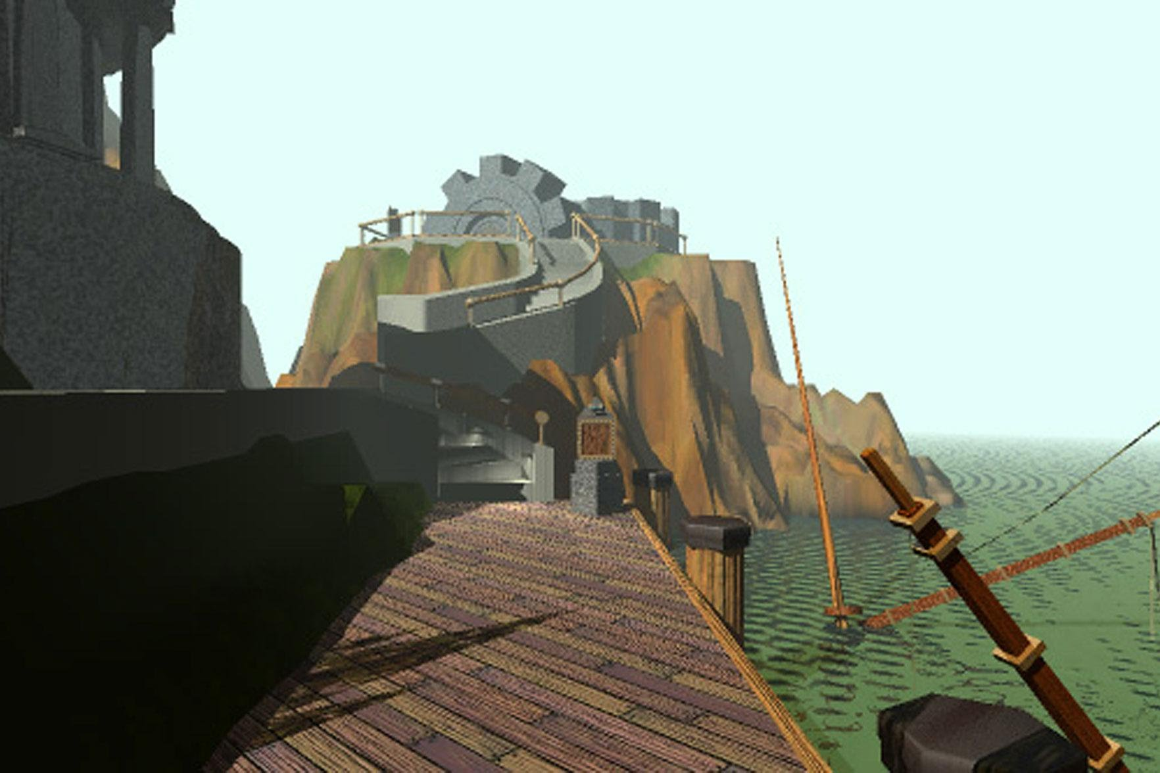
And then, Z
Notes:
MYST brought the idea of fully 3D, immersive worlds.
This was different t han the old pseudo-3D dungeons of games like Akalbeth: World of Doom or the Wizardry games.

Slide 36
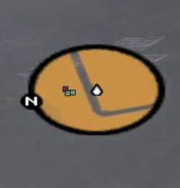
Re-Convergence

Slide 37
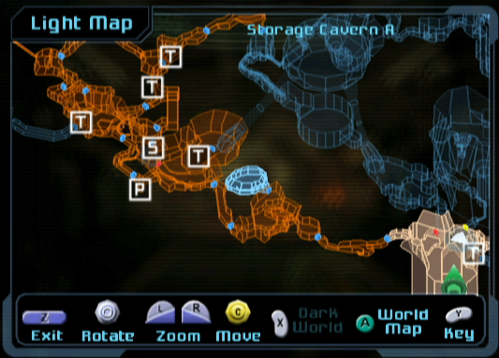
We start exploring 3D maps

Slide 38
Designers abandon 3D maps for 2D Maps
Why?

Slide 39
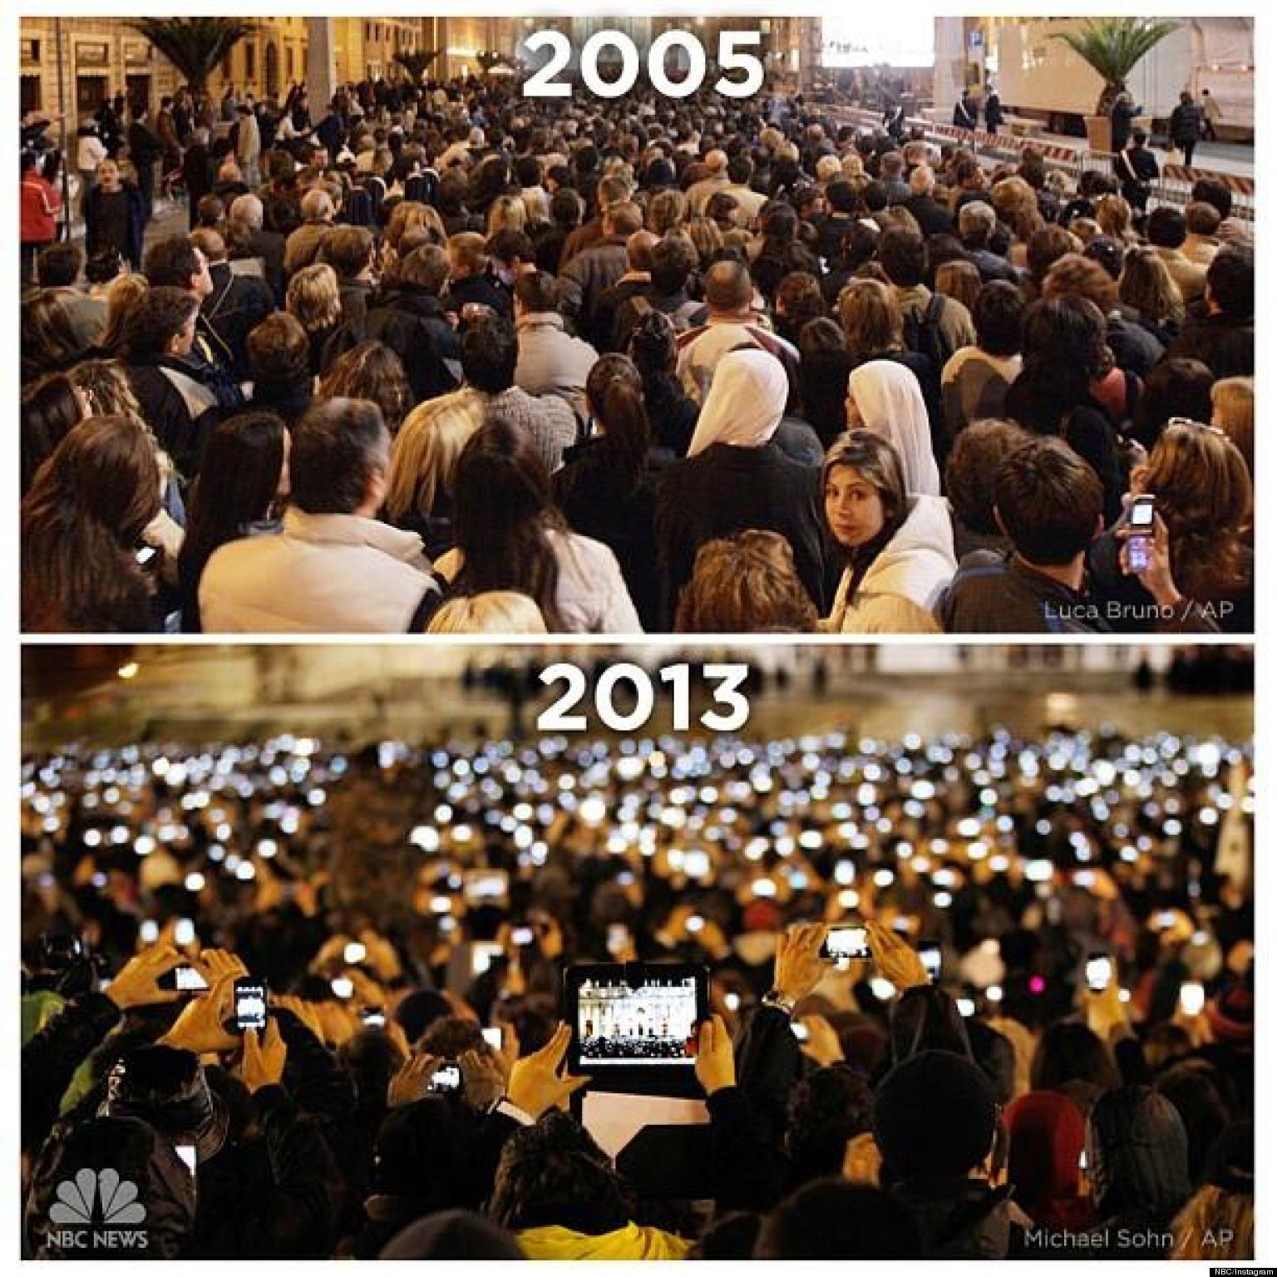

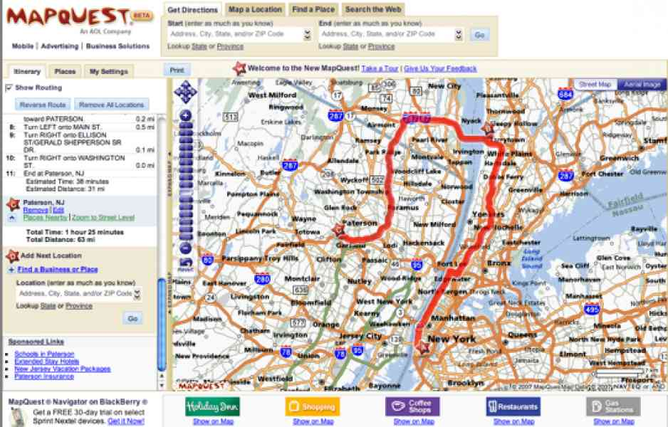
Something else was happening

Slide 40
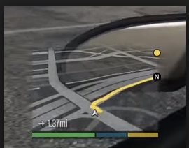
And then…

Slide 41
A Tool Appears
Foster Exploration
Fosters Coordination
Contextualizes Action
But also:
Maps Disrupt Play

